Slide 1
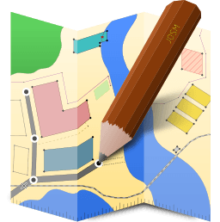

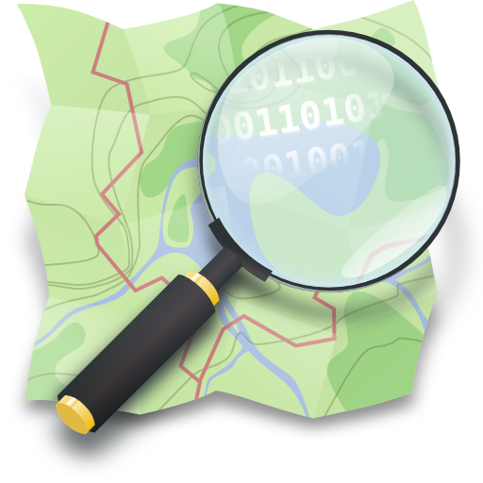
JOSM
Kampala, Uganda

Slide 2
Load Data
Open JOSM
Select all .osm files copied from OMK instances folder to desktop
Drag into JOSM

Slide 3
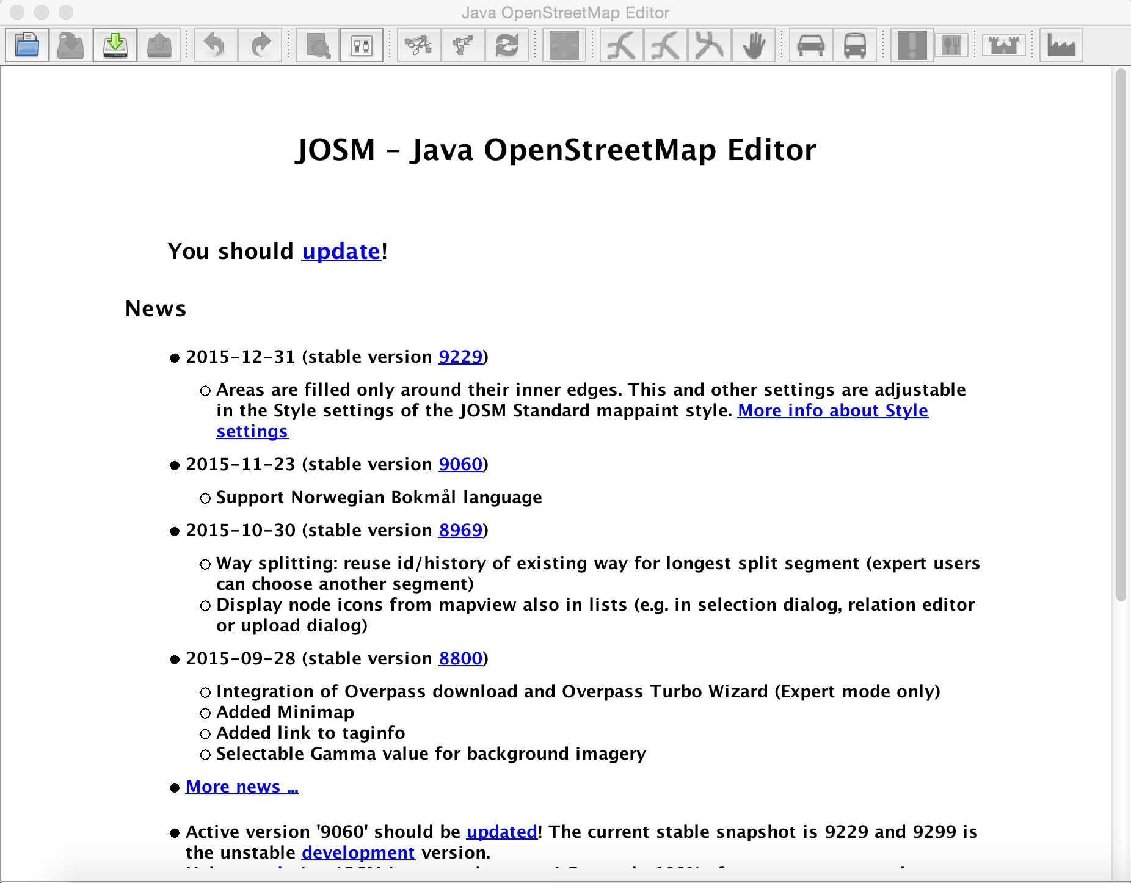

Slide 4
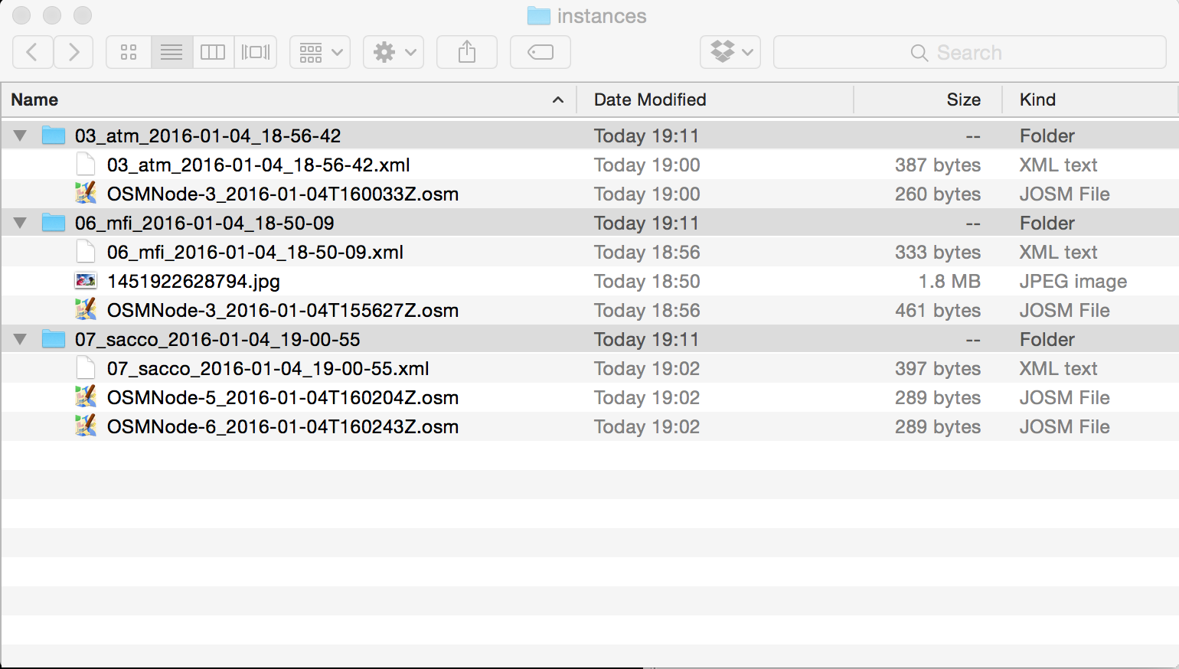
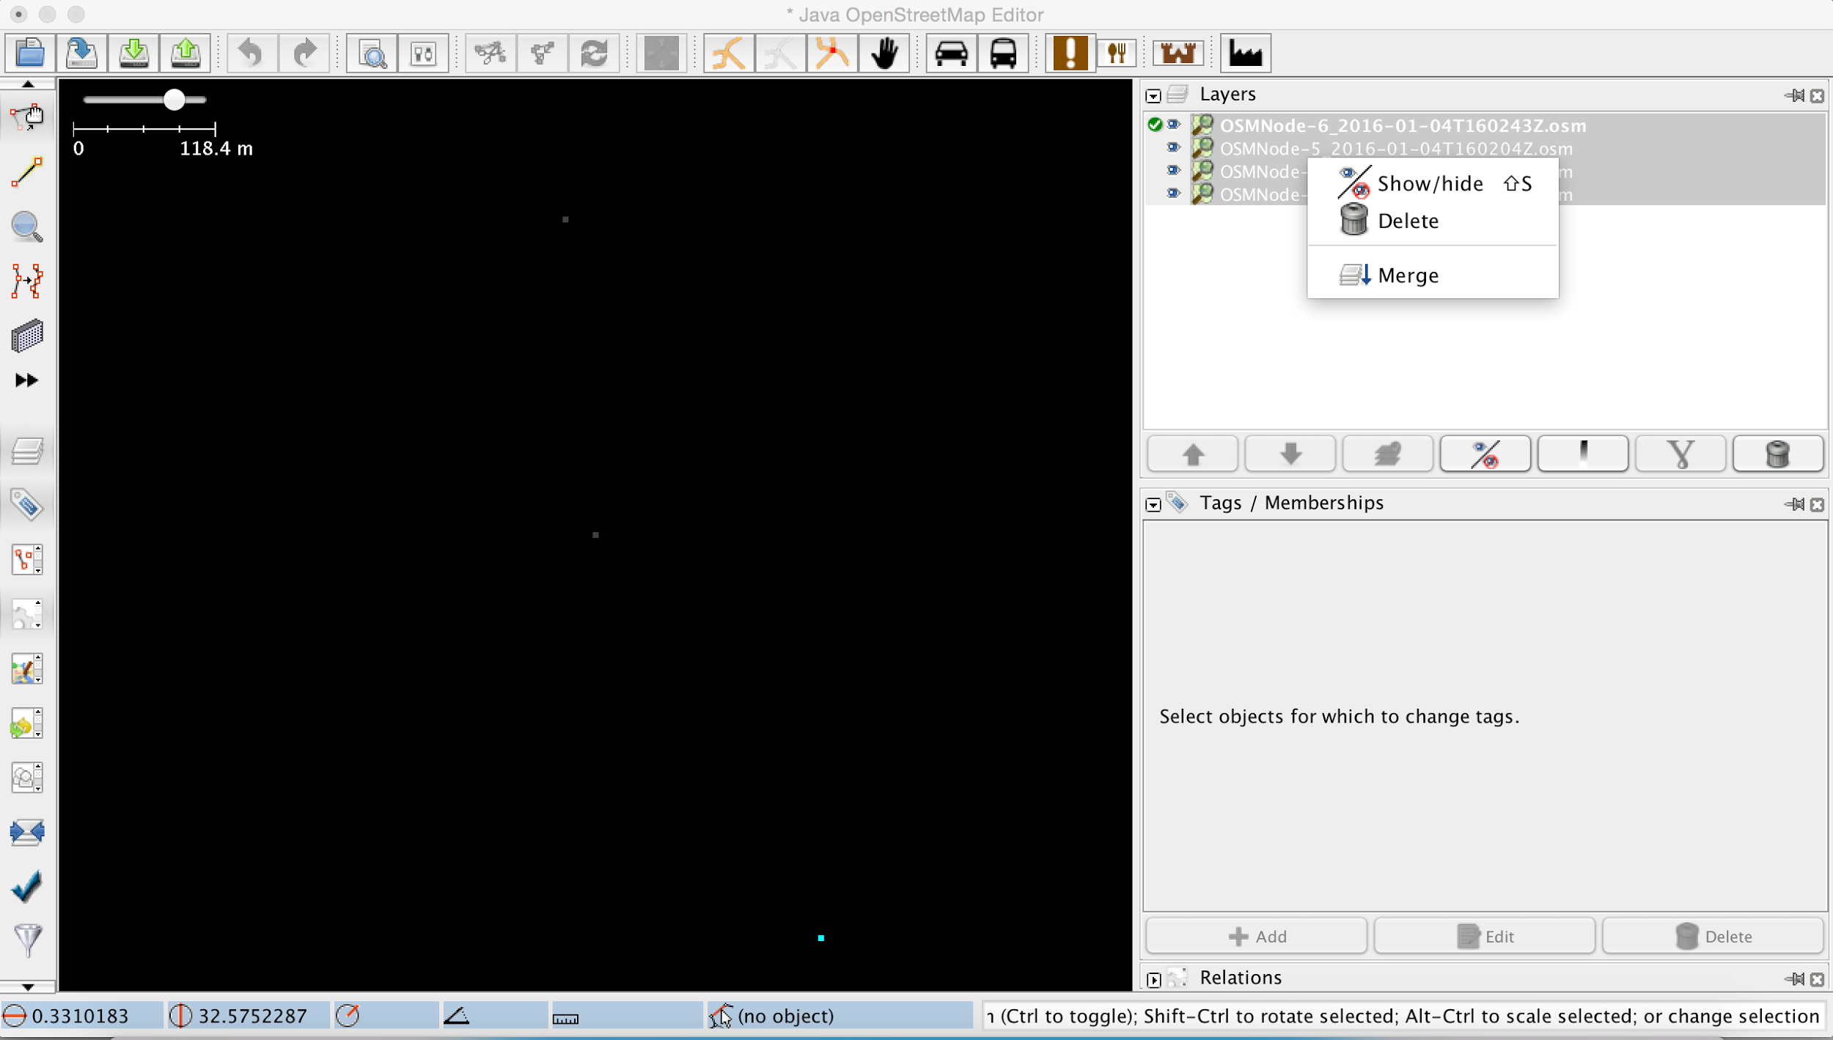

Slide 5
Merge Layers
Select all layers in JOSM
Right-click and select Merge
Select the Target Layer and click Merge (this can be any layer)

Slide 7
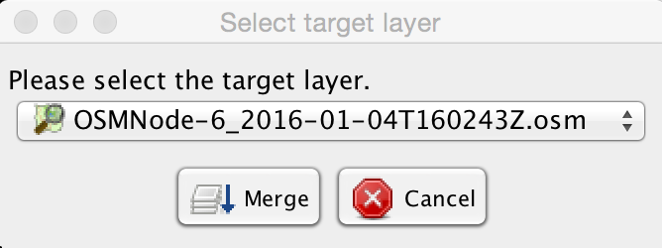

Slide 8
Validate Data
Select Validation button
Expand Errors and Warnings
Read messages
Select node and address errors by editing the appropriate tag(s)

Slide 9
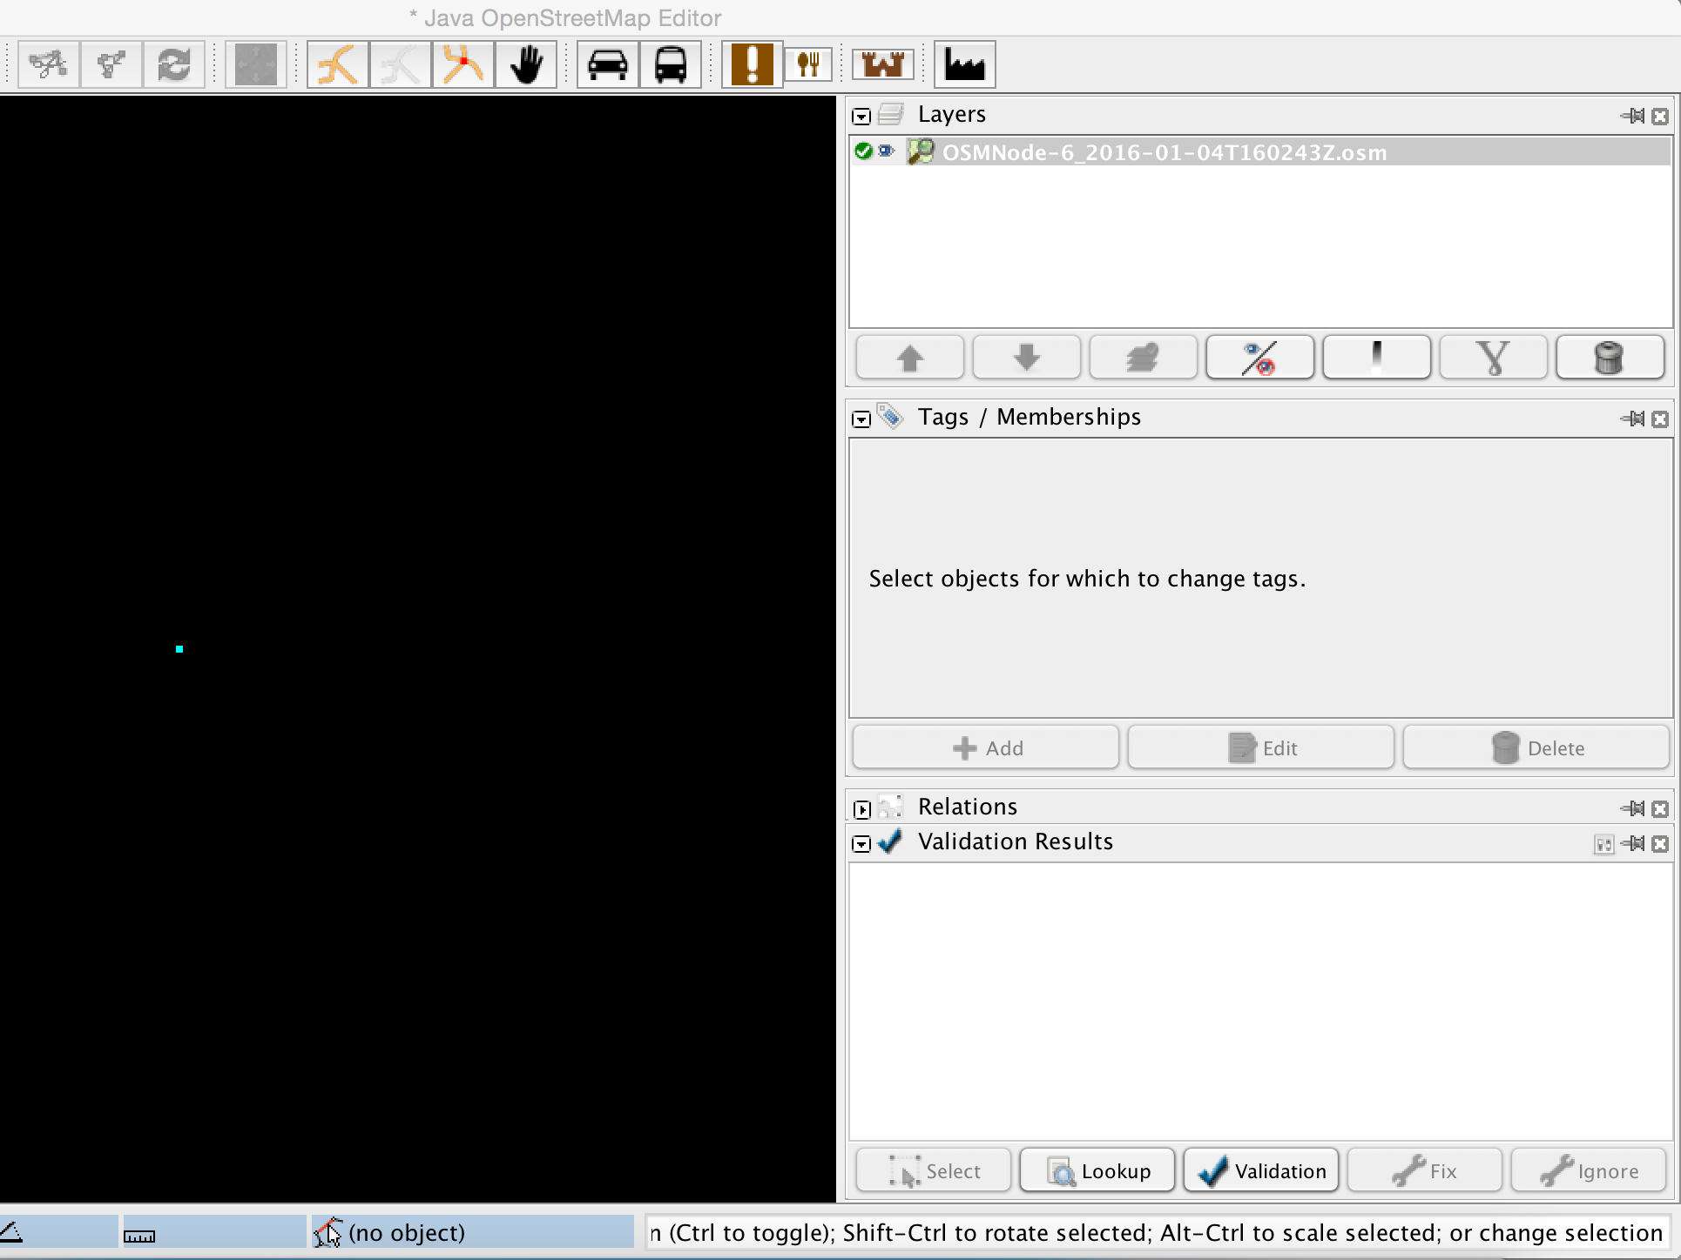

Slide 10
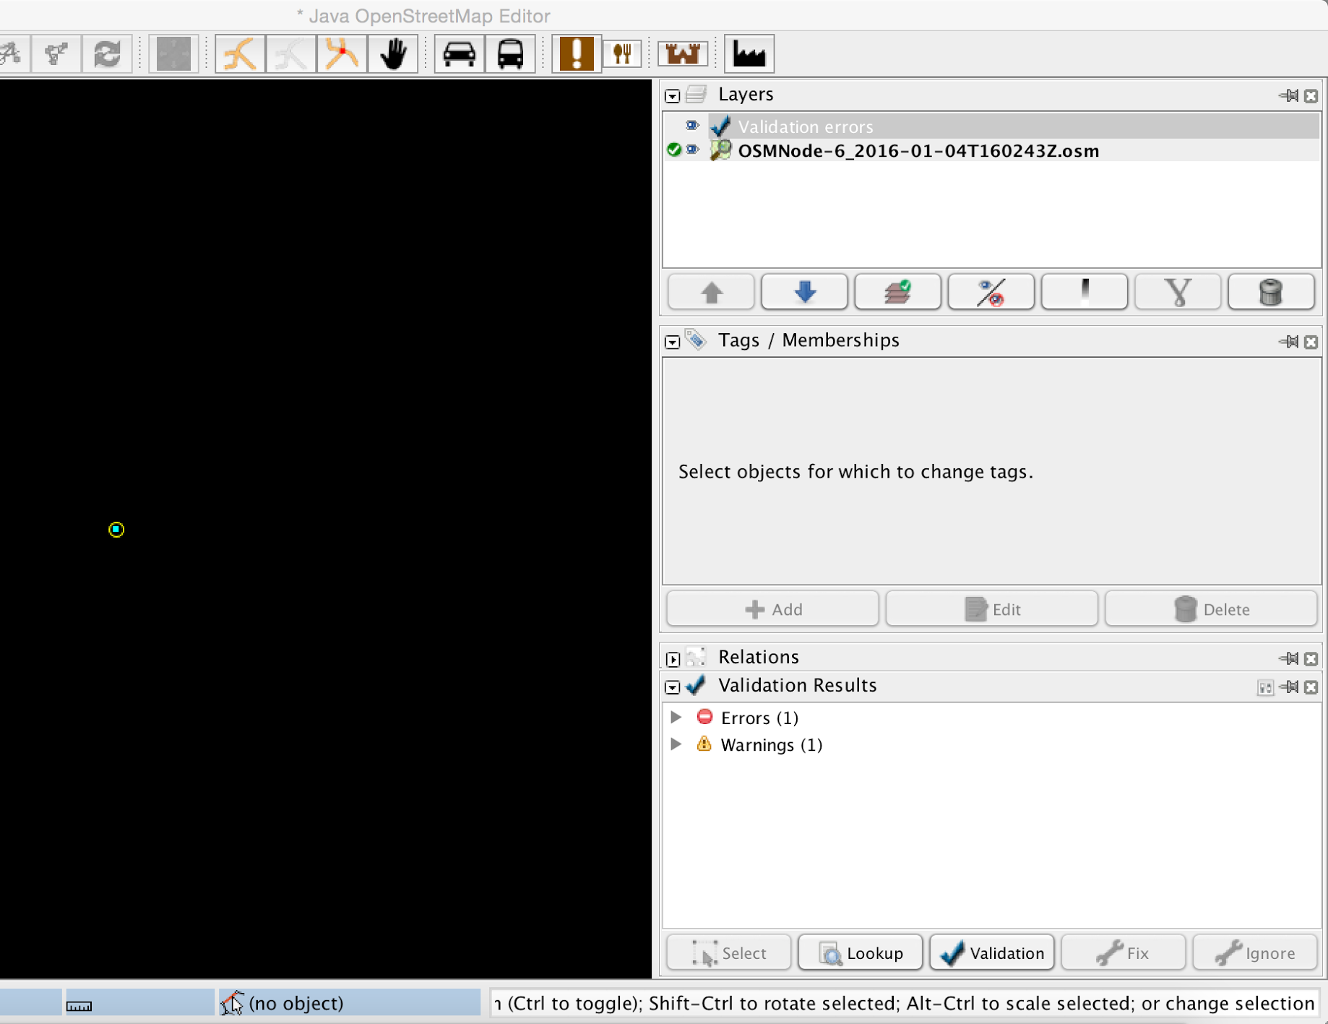

Slide 11
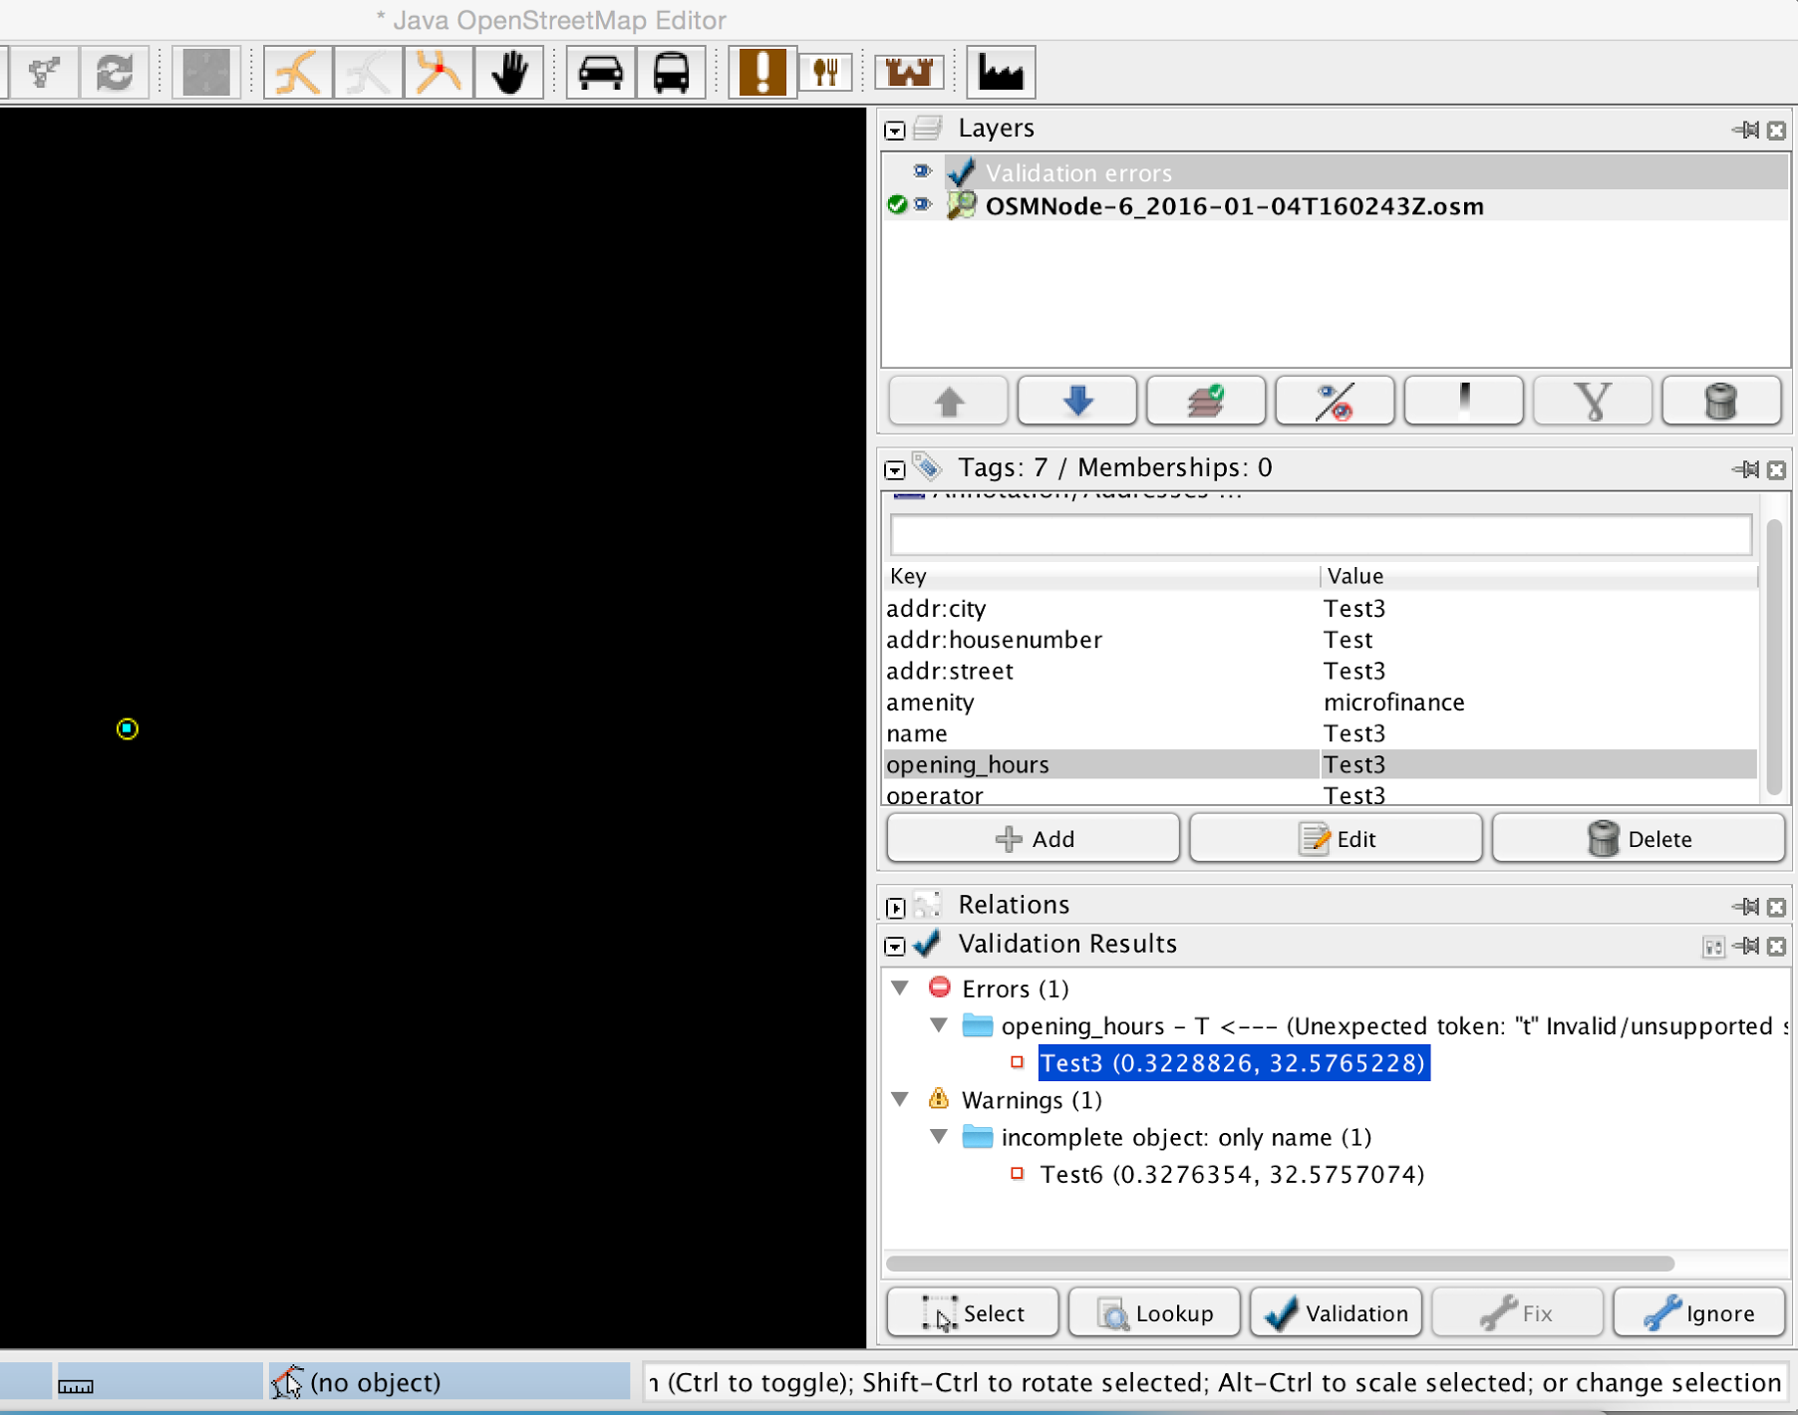
The opening_hours tag is incorrect as it is expecting a number token instead of the character T

Slide 12
Upload Data
Select Upload button
Enter comment for changes: #MapUganda
Specify data source for changes:
Survey
Click Upload Changes

Slide 13
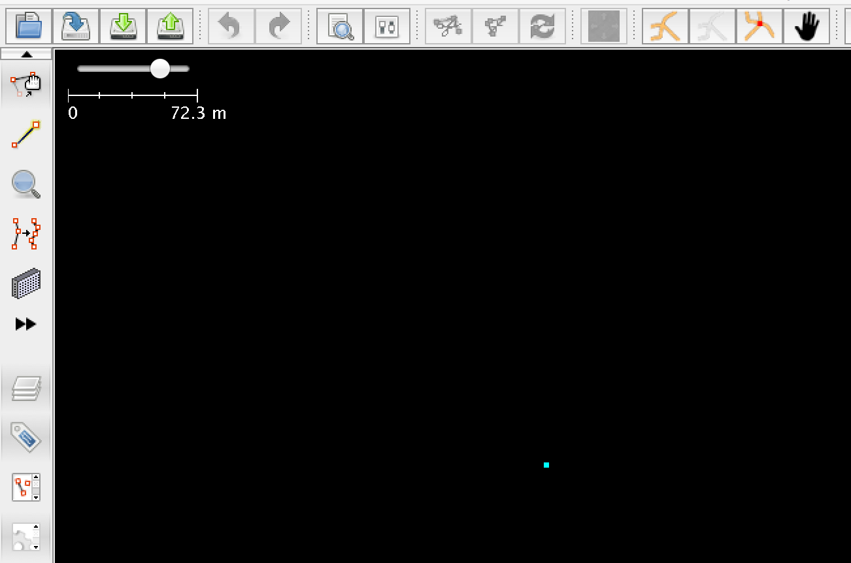

Slide 14
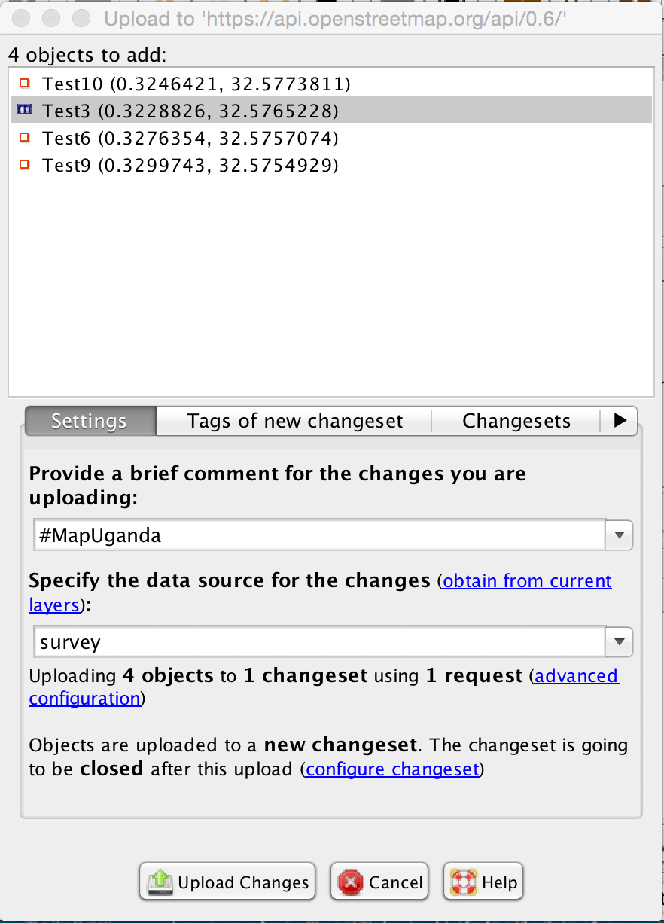

Slide 15
Save Data
Right-click and save merged layer to your laptop with the following name format:
District_Date_OSMUsername.osm
i.e(Kampala_06012016_MatahariMhairi.osm)
Copy the saved file to the appropriate location on #MapUganda external hard drive:
District/Date/Merged
i.e (Kampala/06012016/Merged)

Slide 16
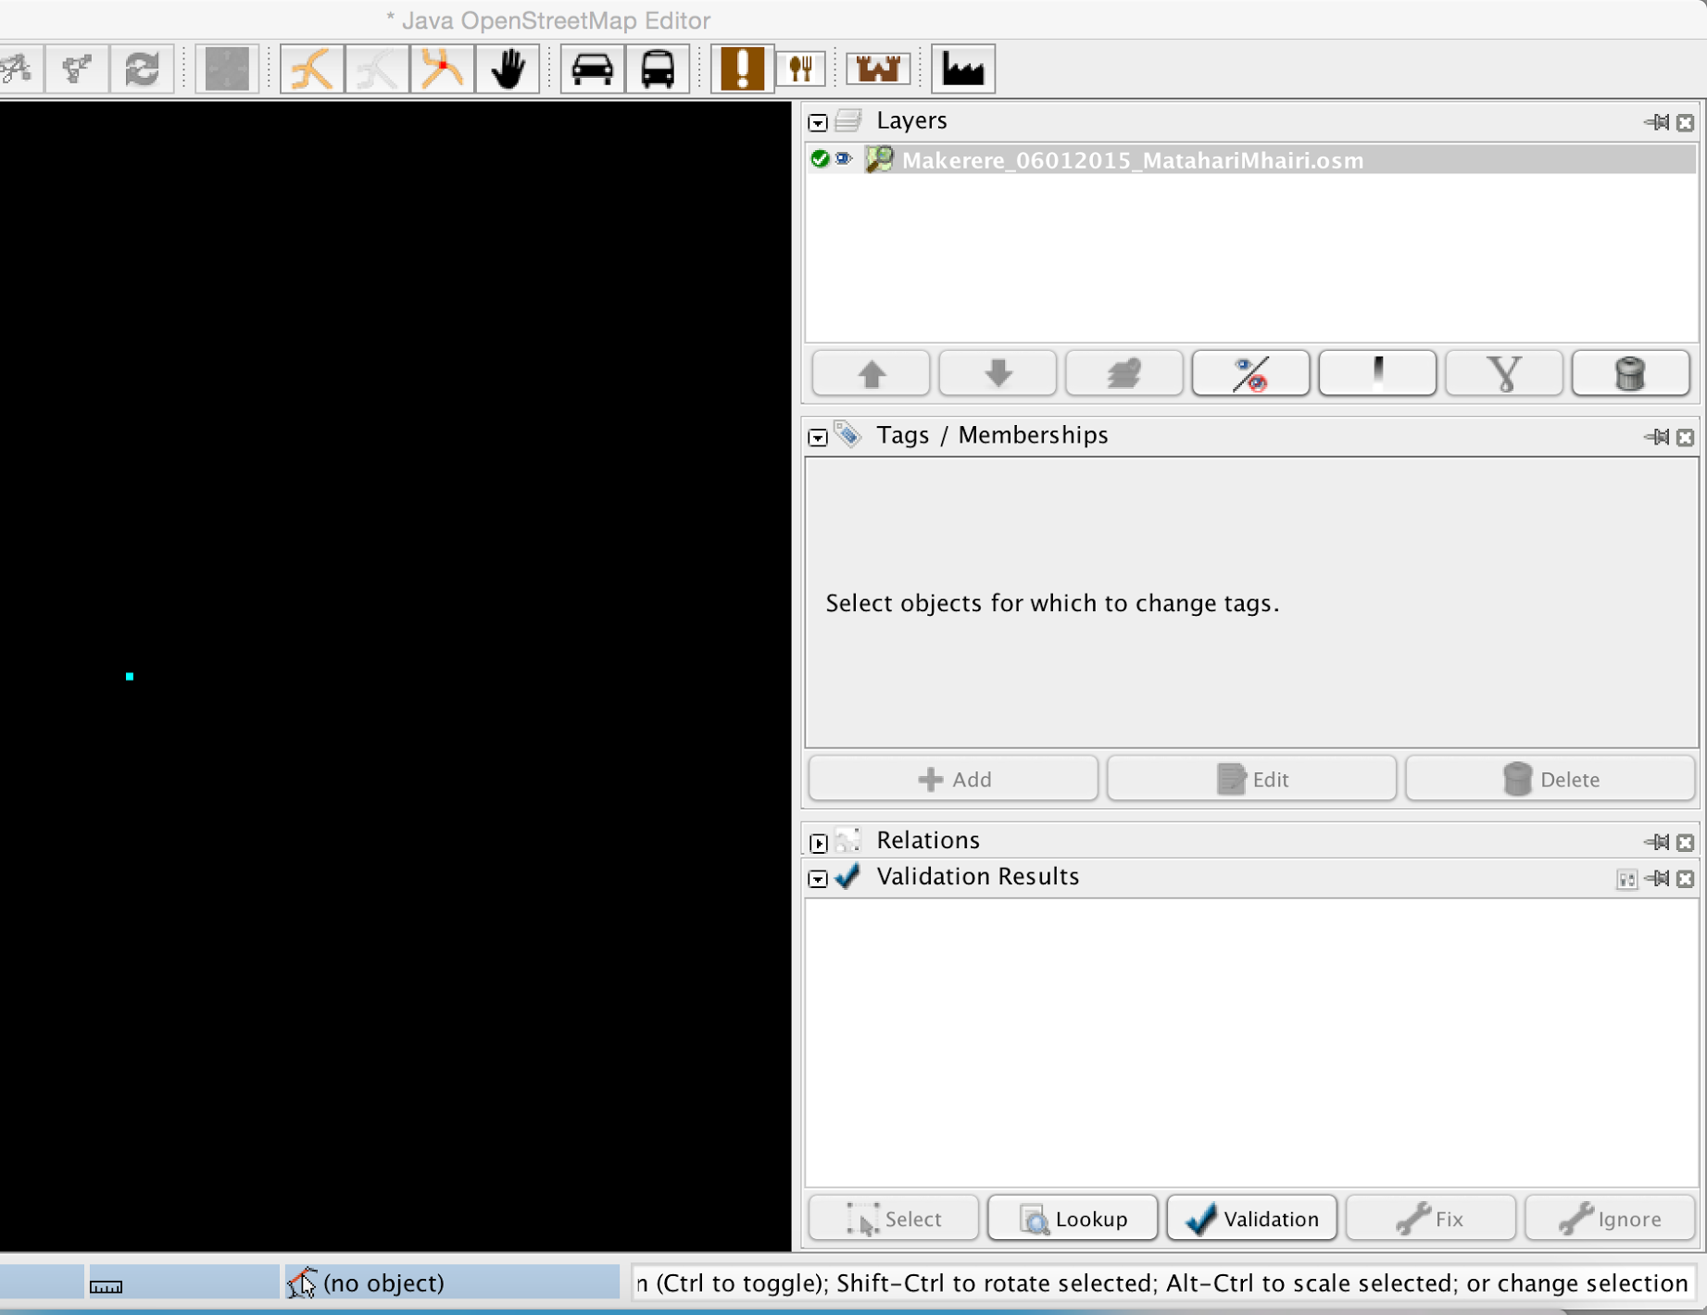

Slide 17
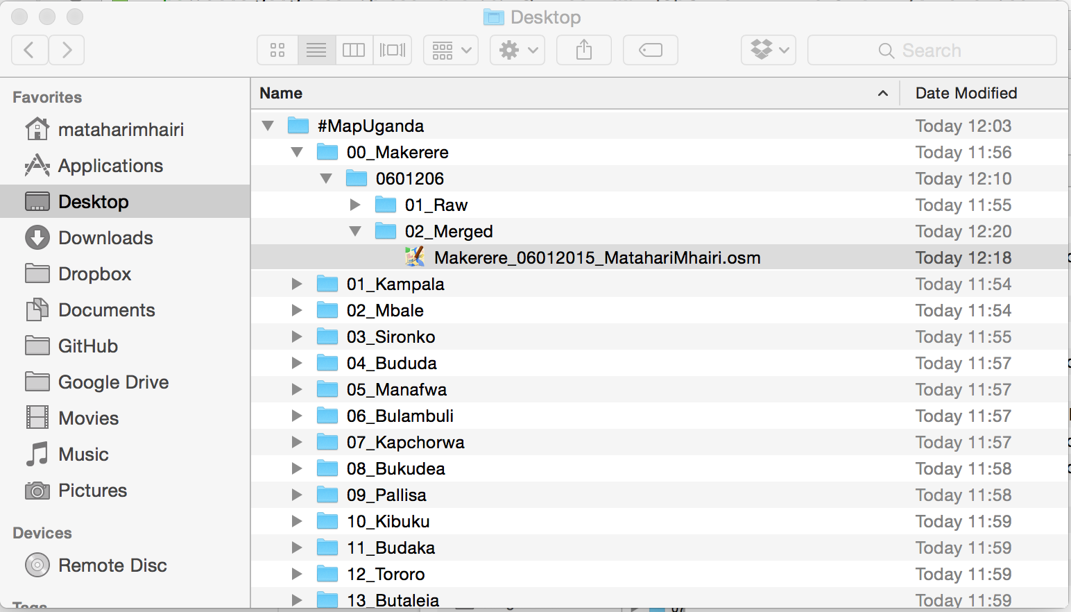
#MapUganda External Hard Drive File Structure

